Slide 1
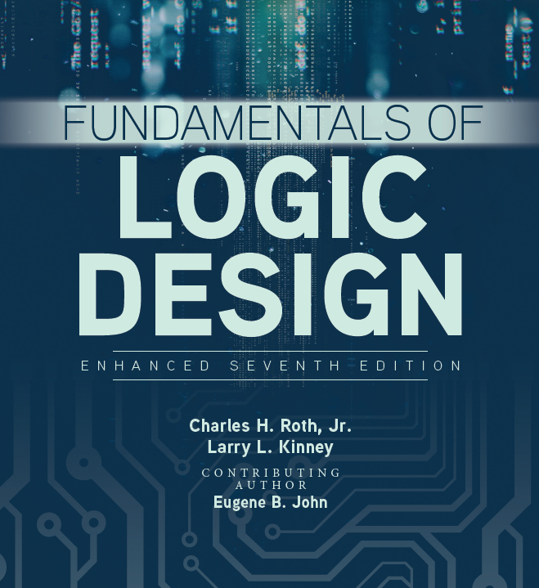

Unit 9 II
Three-state buffer, Encoder, Decoders, Multiplexers, Demultiplexers

Slide 2




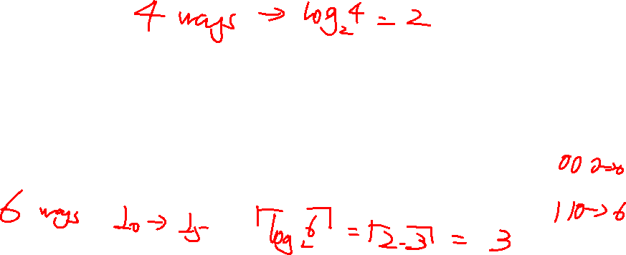
Multiplexers
A multiplexer selects information from one of many input lines and directs it to an output line
I₀ I₁ I₂ I₃
S₁ | S₀ | Y
0 | 0 | I₀
0 | 1 | I₁
1 | 0 | I₂
1 | 1 | I₃
Y
S₁ S₀

Slide 3
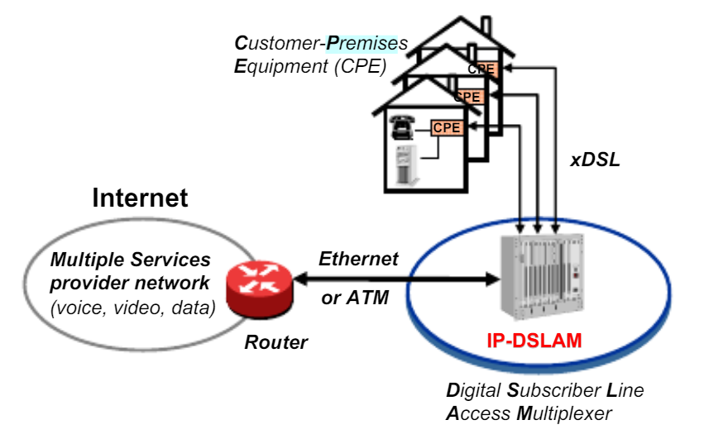
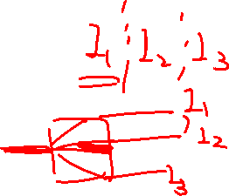
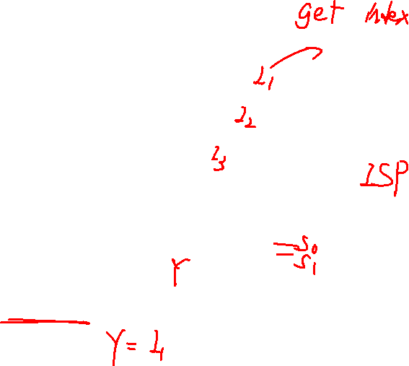
Multiplexers

Slide 4
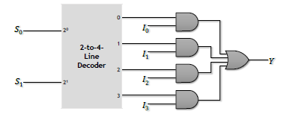
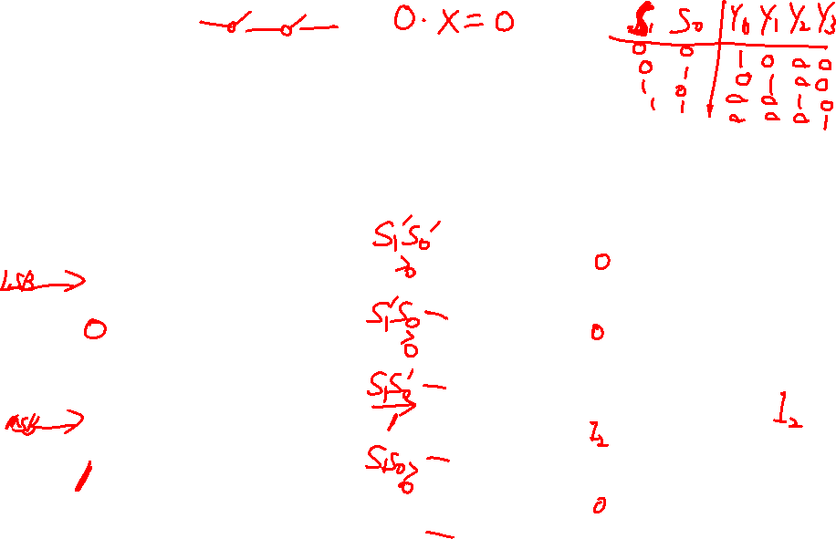
Multiplexers
A multiplexer can be implemented using a decoder, 2-input AND gates and multiple-input OR gate:

Slide 5
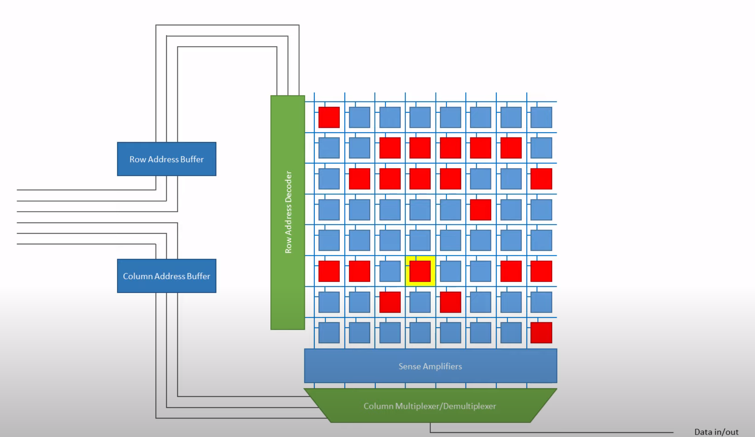
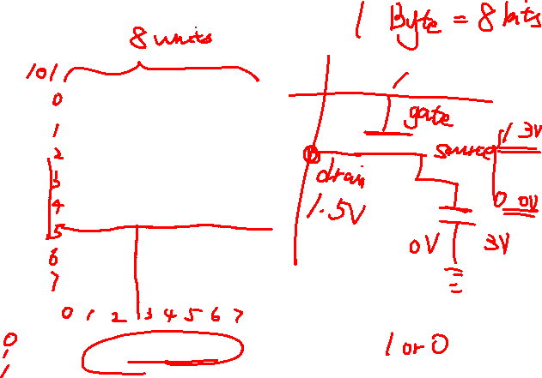
Decoder + multiplexer/demultiplexer application

Slide 6



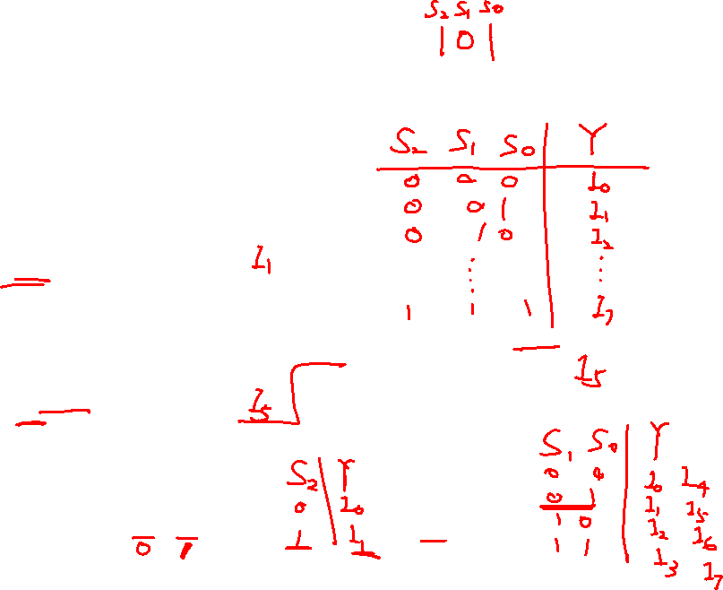
Cascading Multiplexers
8-to-1-line multiplexer
I₀ I₁ I₂ I₃
0 | 4-to-1- Line MUX
1 |  |  | Y
2
3 | S₁ | S₀
0
2-to-1-Line
MUX
S
Y
Y
1
I
4
0
4-to-1-
I₅ I₆ I₇
1
Line
MUX
Y
2
3
^{S}1 ^{S}0
S₁ S₀
S₂

Slide 7


Demultiplexers
A Demultiplexer directs the information from a single input line to one of 2^{n} output lines and is controlled by n control lines
Example – 1-to-4-line demultiplexer:
S₁ | S₀ | Y₀ | Y₁ | Y₂ | Y₃
0 | 0 | I | 0 | 0 | 0
0 | 1 | 0 | I | 0 | 0
1 | 0 | 0 | 0 | I | 0
1 | 1 | 0 | 0 | 0 | I
Y₀ Y₁ Y₂ Y₃
I
S₁ S₀

Slide 8
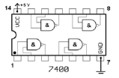
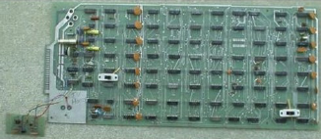

Old ways of implementing digital circuit
Using the fundamental gates NAND gate and NOR gate, different functions can
be achieved.
Resistors, triodes and capacitors are utilized but can only implement a fixed single
function.

Slide 9
Programmable Logic Devices
Programmable Array Logic (PAL):
The PAL (programmable array logic) is a special case of the programmable logic array in which the AND array is programmable and the OR array is fixed
PAL has same structure as PLA in Figure 9-28.

Slide 10
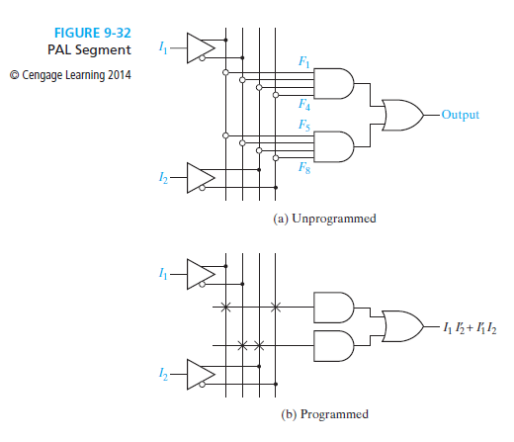
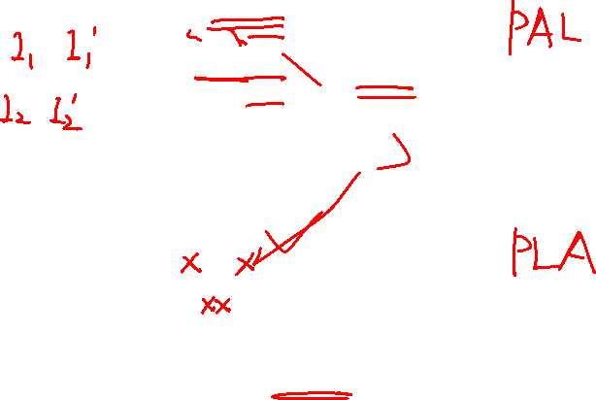
Programmable Logic Devices

Slide 11
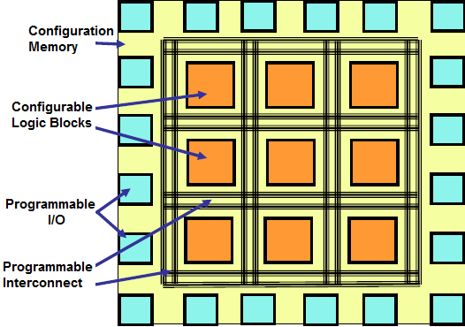
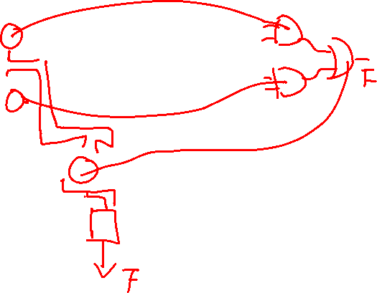
Field Programmable Gate Array(FPGA)

Slide 12
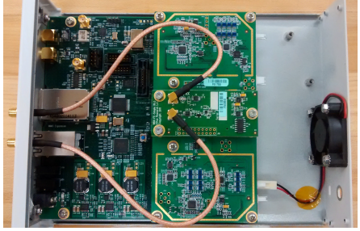
What is Software Defined Radio?
An SDR is a FPGA-based reconfigurable computing platform in which most of the radio functionality is implemented in software.
While traditional hardware-based radios are designed for one or a small number of applications.
Therefore, SDR systems lie at the intersection between RF electronics, embedded computing, and digital signal processing.

Slide 13
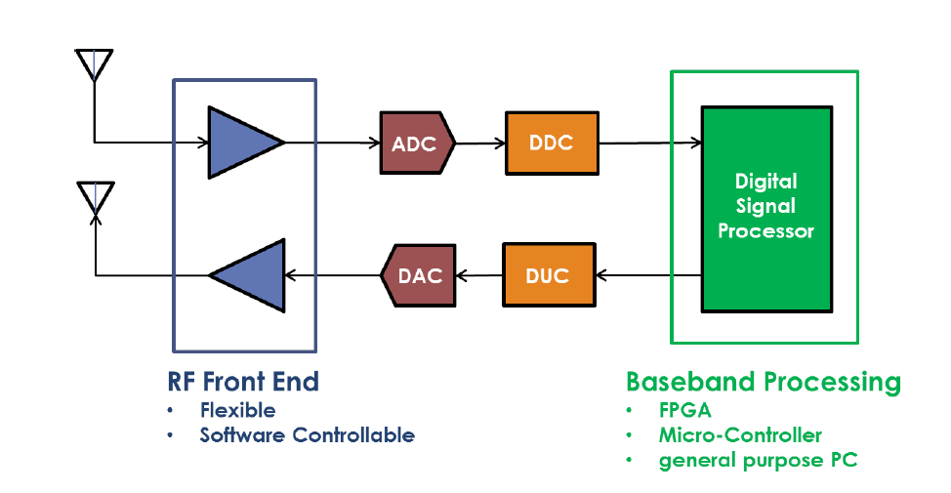
SDR Transceivers

Slide 14
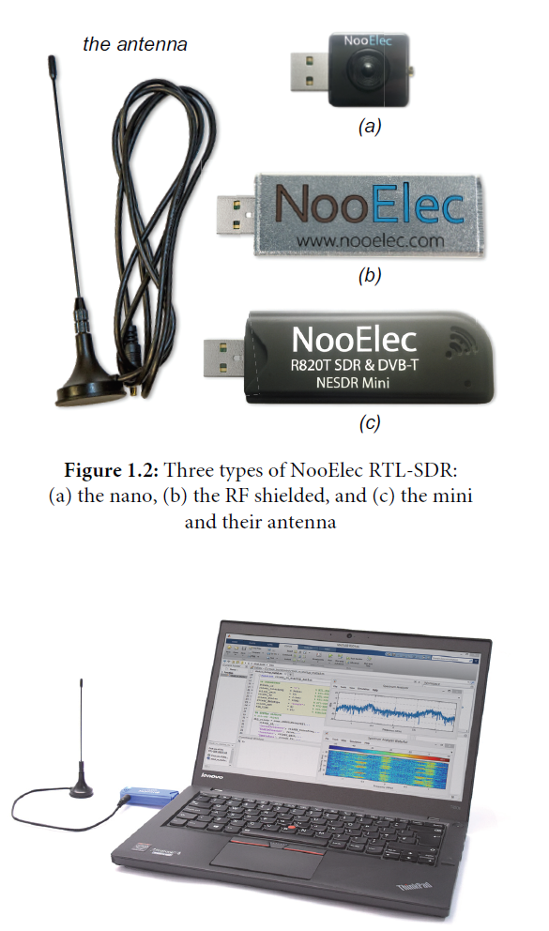
RTL-SDR
RTL-SDR is a USB device to receive the RF radio signals. By tuning the receiving frequency, it is capable to demodulate the received signal.

